Slide 1
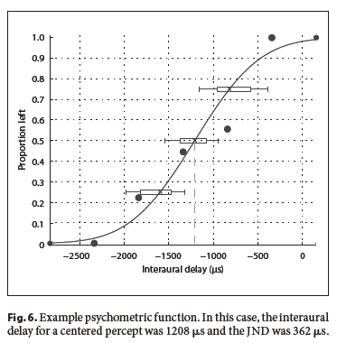
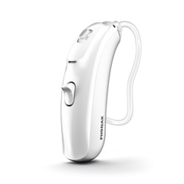
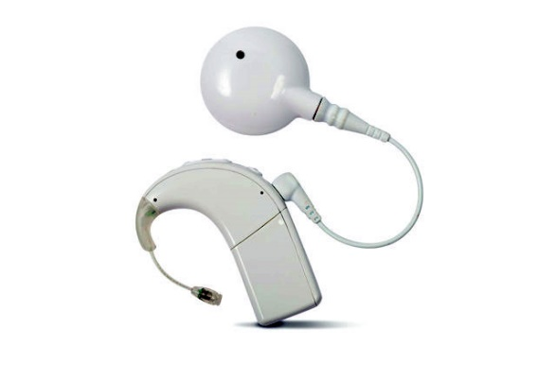
Sensitivity to binaural cues in bimodal hearing
Complimentary benefit of having different type of information
Binaural benefit of listening with two ears for bimodal listeners: binaural redundancy & better ear effect (Ching et al., 2007; Olson and Shinn, 2008)
Sensitivity to binaural cues in bimodal hearing in laboratory settings (Francart et al., 2009; Francart et al., 2011)
Francart et al. 2011

Slide 2
ITD sensitivity of an IC neuron to electrical pulse train (ipsi) and acoustic clicks (contra)
Response to low rate (20 Hz) electrical pulse train and acoustic clicks
Strong response to both stimuli for large positive (acoustic leading, >4 ms) and negative (electric leading, <0ms) ITDs
Acoustic response delay τ_{A} = 10.3 ms is longer than electrical response delay τ_{E} = 8.2 ms, yielding a 2.1 ms estimated D_{e}

Slide 3
Neural ITD sensitivity to bimodal stimulation

Slide 4
ILD sensitivity of an IC neuron to electrical pulse train (contra) and acoustic clicks (ipsi)
Firing rate of an IC neuron to 640-pps pulse train (contra) and broadband noise (ipsi) as a function of stimulus level in each ear
The contralateral electric stimulus varied from −10 to −2 dB re 1mA and the ipsilateral acoustic stimulus from 10 to 60 dB SPL to cover dynamic range for each stimulus

